Slide 1

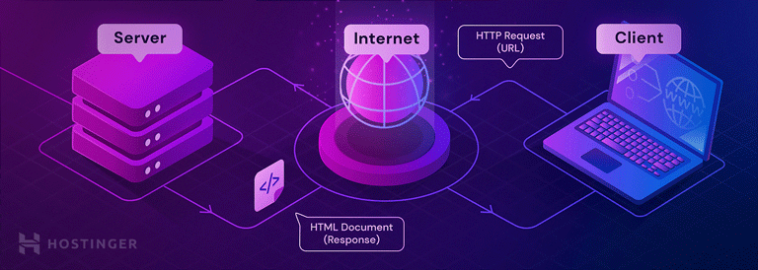
Thread Pool Server
Name: Ammar Y Hobi ID:1768459 Team:1
Nov 8th 2022

Slide 2

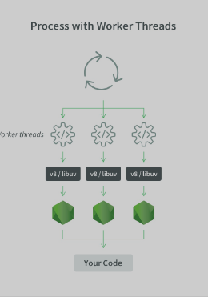


Agenda
What is a thread pool server?
Worker thread
Overload handle strategy
Analysis on the thread
&
Overload strategy

Slide 3
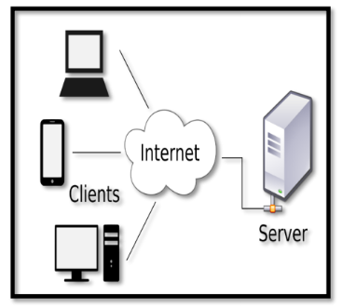
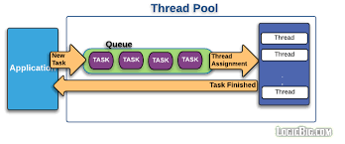
What is the thread pool ?
is that create a specified number of threads at the start and then assign task to them.
Figure 1 : optimal client web server
Figure 2 : Web server process

Slide 4
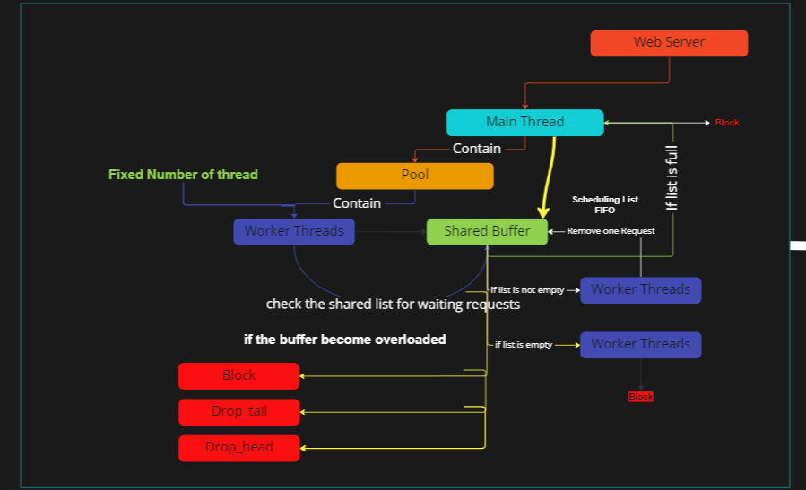

Slide 5
Thread Pool
Worker threads
serve
Thread1
serve
Thread2
Req6
Req5
Req4
Req3
Req2
Req1
serve
Thread3
Shared buffer

Slide 6

Overload handle method
Req6
Close the socket
Req5
Req4
Req3
Req2
Req1
BLCK
Req6
Close the socket & remove new Req
Req5
Req4
Req3
Req2
Req1
DRPT
Req6
Close the socket & remove old Req and not being serve it
Req5
Req4
Req3
Req2
Req1
DRPH

Slide 7
Thread Pool
Worker thread
Thread1
Thread2
Req
6
Req5
Req
4
Req3
Req
6
Thread3
Shared buffer

Slide 8
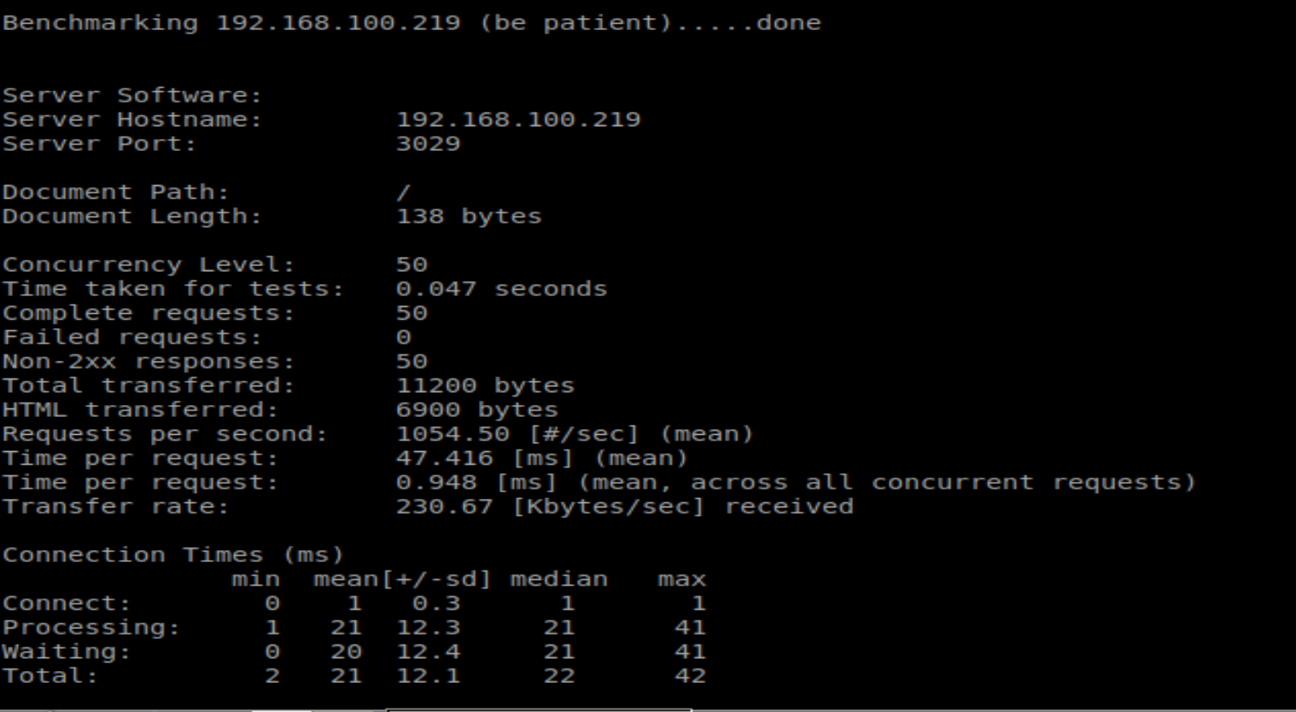
Analysis on number of threads & over load hanle (Default)
<ab –n 50 –c 50 192.168.100.219:3029/

Slide 9
Analysis performance #threads, overload handle
Input argument | Time per request m/s | Average waiting m/s | Test time s
Pth=2,B =10 , BLCK | 0.351 | 6 | 0.018
Pth=2,B =10 , DRPT | 0.101 | 3 | 0.010
Pth=2,B =10 , DRPH | 0.760 | 14 | 0.038
Pth=4,B =10 , BLCK | 0.129 | 3 | 0.0130
Pth=4,B =10, DRPT | 0.605 | 14 | 0.041
Pth=4,B =10, DRPH | 0.597 | 14 | 0.030
Pth=8,B =10, BLCK | 0.794 | 15 | 0.040
Pth=8,B =10, DRPT | 0.871 | 19 | 0.044
Pth=8,B =10, DRPH | 0.948 | 21 | 0.047

Slide 10

Thank you

